Slide 1
Principal Sessoms Report
Dunbar Elementary
GO Team Meeting #1
9/15/22

Slide 2
TOPICS
School Start Update
Current Enrollment & Leveling
School Strategic Plan
Strategic Plan Overview
SMART Goals
GMAS Results

Slide 3
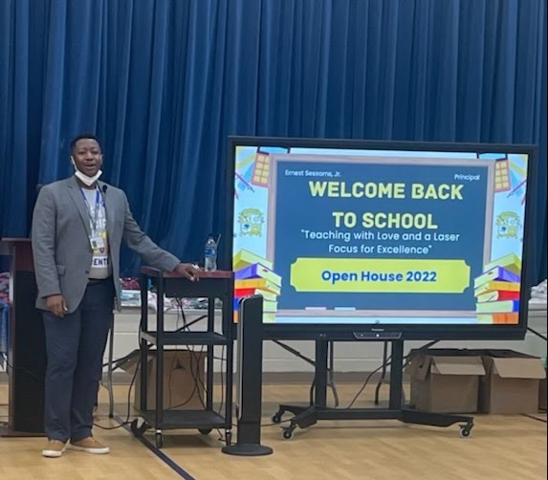
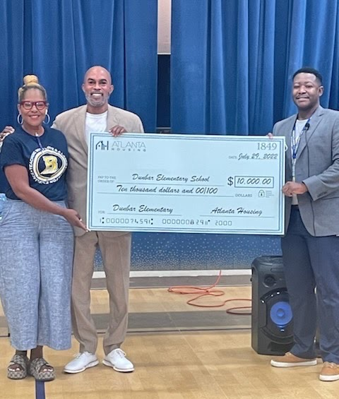
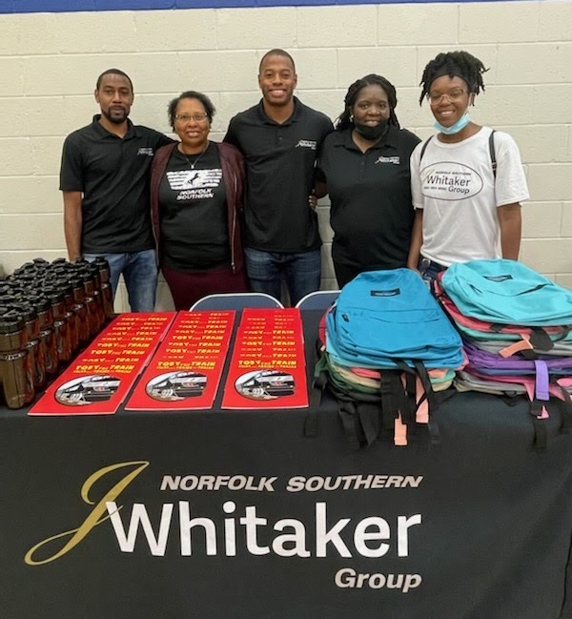
School start UPDATE

Slide 4
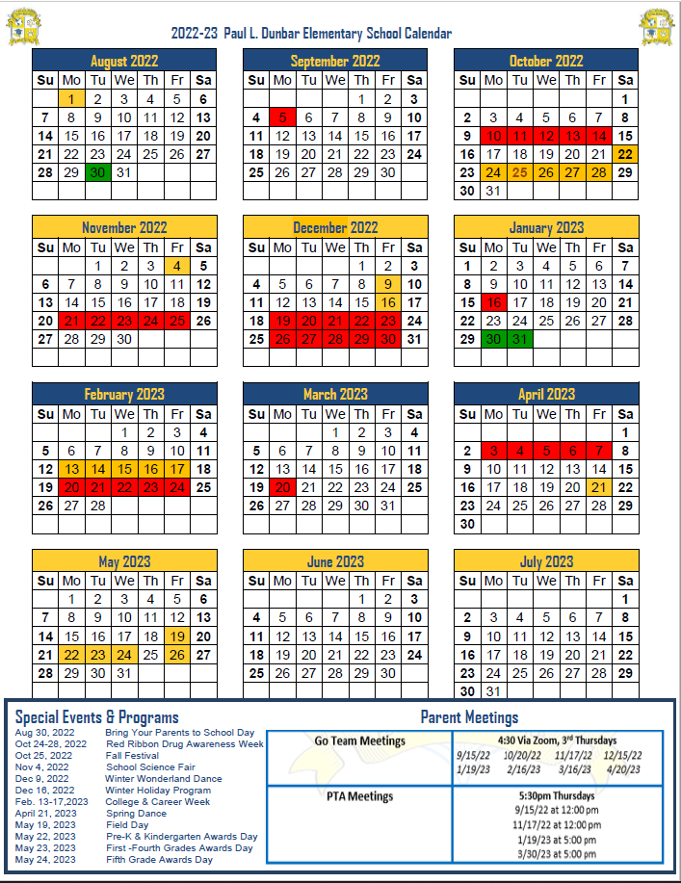
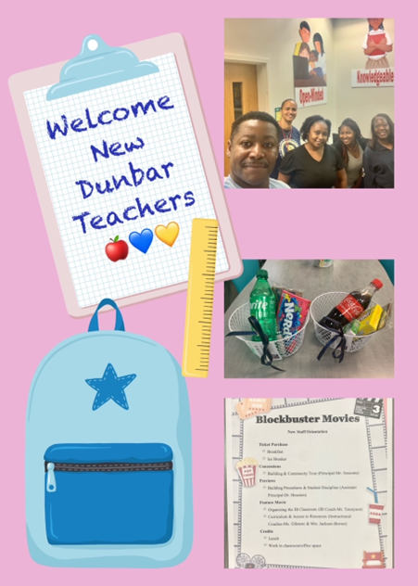
General Information about Start of School
6 New Teacher
1 Media Specialist
1 Parent Liaison
1 Paraprofessional
Notes:
Principals – please provide a general update as to how the school year is going

Slide 5
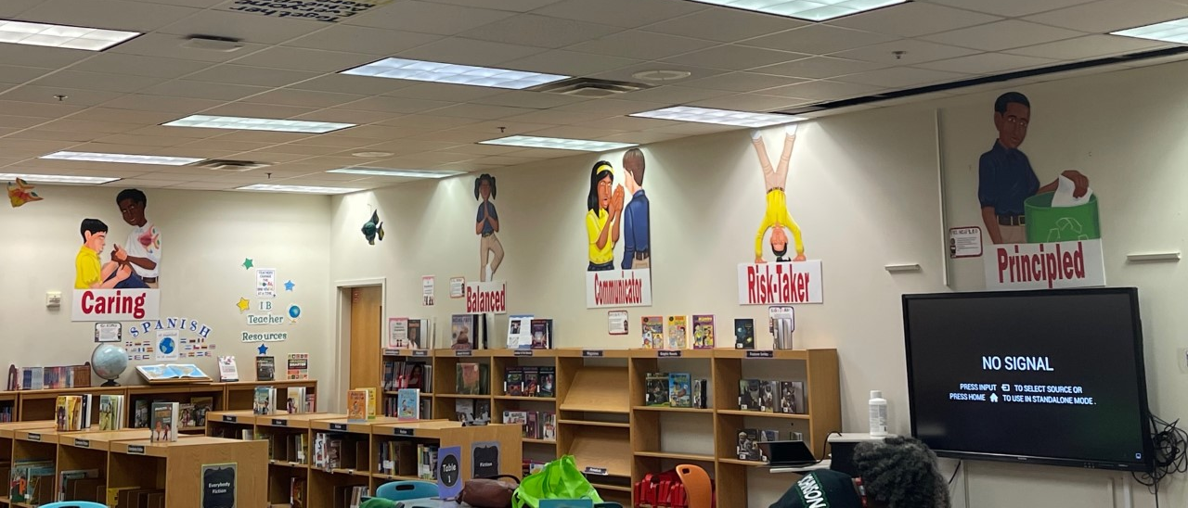
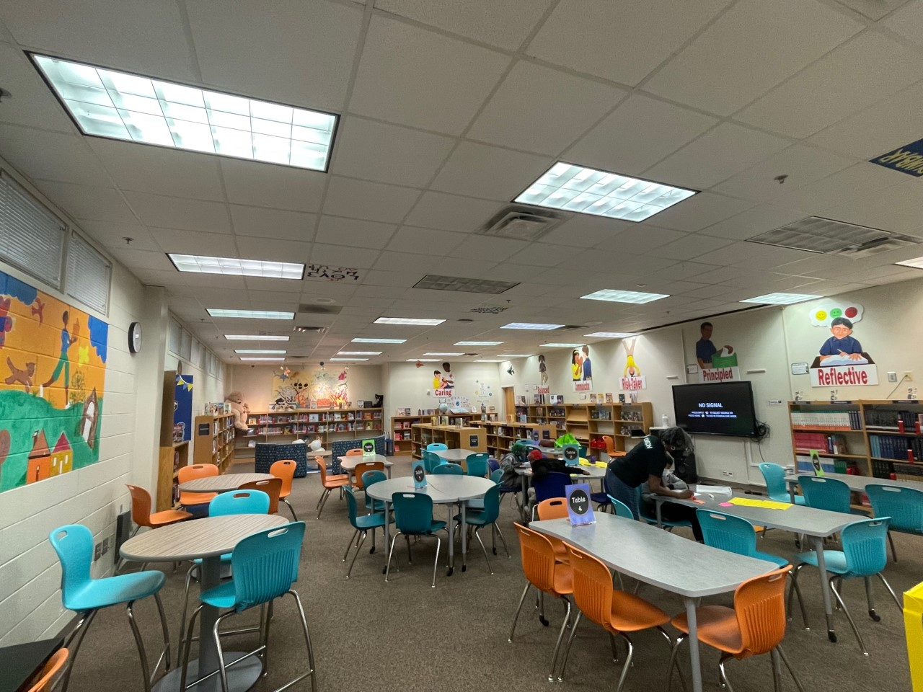
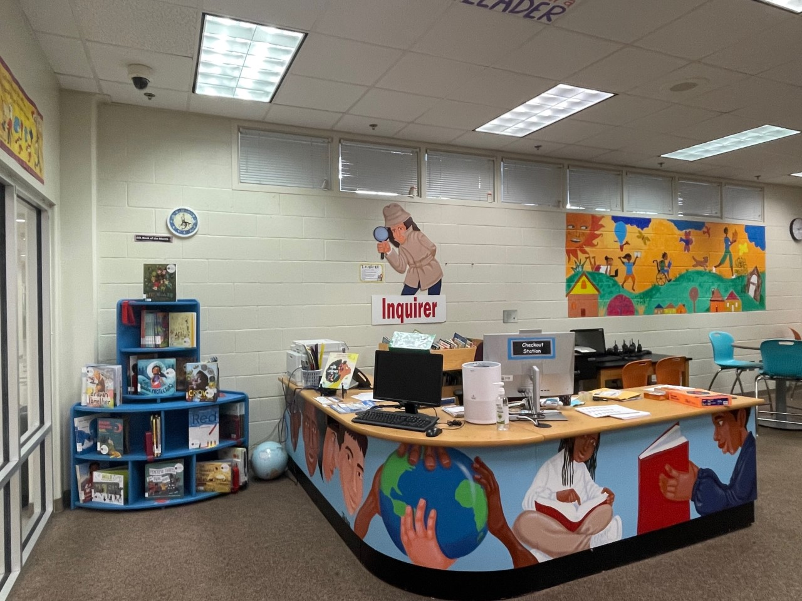
General Information about Start of School
*Upgraded Media Center
Furniture and New Books
Notes:
Principals – please provide a general update as to how the school year is going

Slide 6
Enrollment
As of
8/16/22
As of
9/7/22
Projected Enrollment | 276 | 276
Current Enrollment | 261 | 289
Difference | -15 | +13
Leveling
Leveling is the process the District uses to adjust school budget allocations to match student enrollment.
Budget Impact
Notes:
Principals: Based on your enrollment, please give your GO Team the information on how you plan to account for any budget changes due to leveling.

Slide 7
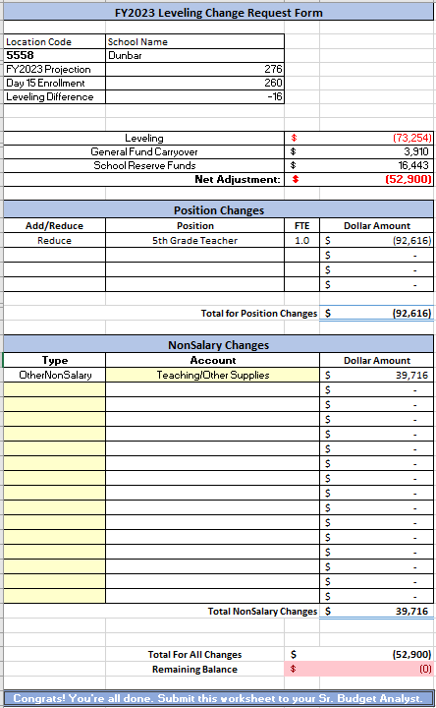
Leveling
Budget Impact
Notes:
Principals: Based on your enrollment, please give your GO Team the information on how you plan to account for any budget changes due to leveling.

Slide 8
2021-2025 Strategic Plan

Slide 9
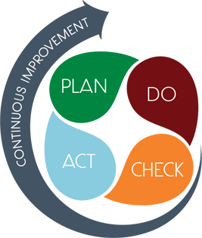
Strategic Plan Smart Goals
Overview
Priorities
Key Aspects
SMART GOALS

Slide 10
Mission-Paul Laurence Dunbar Elementary is a school that nurtures and develops life- long learners who are problem solvers and internationally minded citizens.
Paul L. Dunbar Elementary
Vision-Paul Laurence Dunbar is a school where excellence is expected and all students are developed academically, socially, and emotionally in order to become globally competitive.
SMART Goals
Increase the % of grades 3-5 students scoring proficient or above in reading from 17% Spring GMAS 2019 to 20% on Spring GMAS 2022
Increase the % of grades 3-5 students scoring proficient or above in math from 15% on Spring GMAS 2019 to 18% on Spring GMAS 2022
Reduce the number of insubordinate behavior referrals by 10% from 2019 to 2021-2022 SY
Increase parent participation in school hosted events
APS Strategic Priorities & Initiatives
School Strategic Priorities
School Strategies
Fostering Academic Excellence for All
Data
Curriculum & Instruction
Signature Program
1. Weekly Data Review PLCS
2. International Baccalaureate school-wide implementation
3. Focus on Literacy and Math instructional best practices
1A. Review of NWEA/MAP, HMH, Attendance, and Behavior Data weekly
1B. Quarterly Parent Teacher Data Conferences
1C. Learning Walks for Intervention, Guided Reading, IB, and Math
Building a Culture of Student Support
Whole Child & Intervention
Personalized Learning
Intervention Block with HMH
After School Tutorial
BASC-3 Behavior Screener
Weekly CARE Team Meetings
2A. Care Team weekly meetings and student tracker
2B. Pre and Post Data for students attending after school tutorial
2C. Full-time Wrap-Around Supports (Counselor, Behavior Specialist, MTSS, Social Worker)
Equipping & Empowering Leaders & Staff
Strategic Staff Support
Equitable Resource Allocation
8. Grade Level Leaders
9. Leadership Development Opportunities (Coordinators;Club Sponsors)
10. ESOL,SPED, & Homeless Inclusion
3A. PLC Norms and Protocols
3B. After School Coordinator Leadership Opportunities and Planning Meetings
3C. Allocation of General Budget and other funding sources for ESOL, SPED, & Poverty Students
Creating a System of School Support
Collective Action, Engagement & Empowerment
4A. Monthly School Newsletters
4B. Monday Folder communication of flyers and announcements
4C. Social Media Blasts
4D. Robo Calls and Class Dojo
11. Community Partners Network
12. On-Campus AVLF resources
13. Parent Liaison and Parent Center
14. Community CARE Closet
15. Sheltering Arms Educare Center

Slide 11
Georgia Milestones Assessment Results

Slide 12
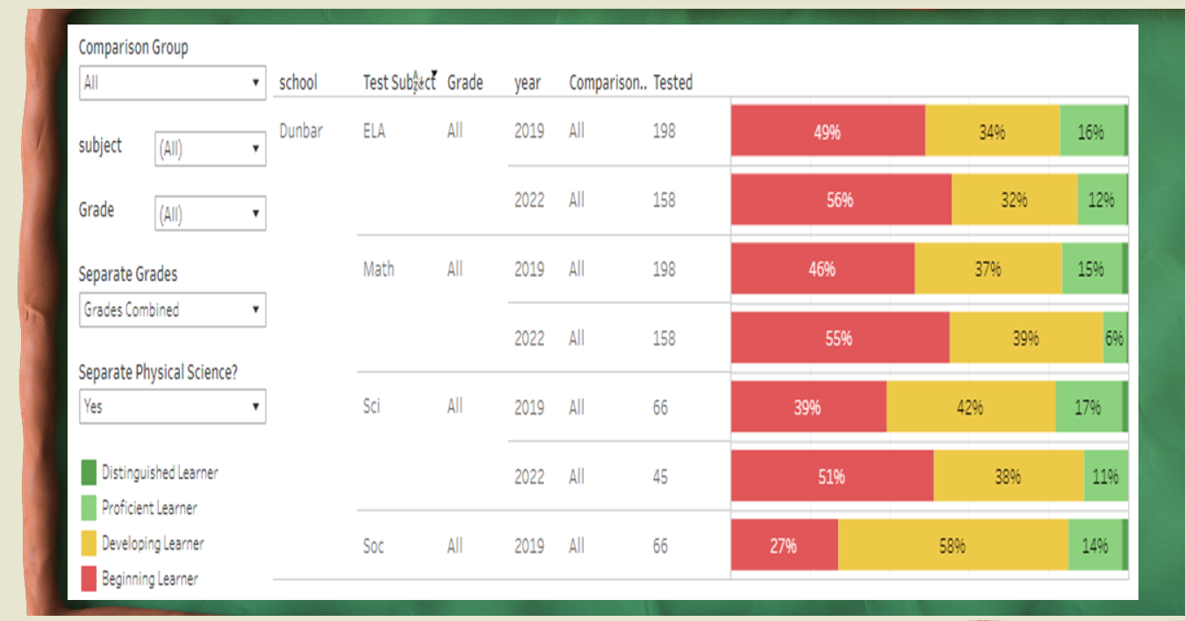
GMAS 2019 & 2022 Results

Slide 13
GMAS Results

Slide 14
GMAS Results

Slide 15
Glows & Grows
Glows
Grows
Teachers are more proficient in ELA curriculum implementation for Guided Reading & Fundations Phonics
IB Authorization visit scheduled 9/26-27/22.
Increased enrollment over projections.
Monetary Grants and Partnerships for PPE and School Supplies
New Playground Area Coming!!
Increased student achievement in ELA
Increased student achievement in Math
Improve student attendance

Slide 16
Questions?

